Slide 1

District Energy Corporation
Sustainable Project
SW 40th Thermal Energy Facility
To Serve the New Lancaster County Adult Detention Facility
April 2011

Slide 2
Project Overview
Geothermal Heat Pump Central Plant
Serving County Adult Detention Facility
779 Beds
270,000 Square Feet
Domestic Hot Water Pre-Heat System
Emergency
Power System

Slide 3
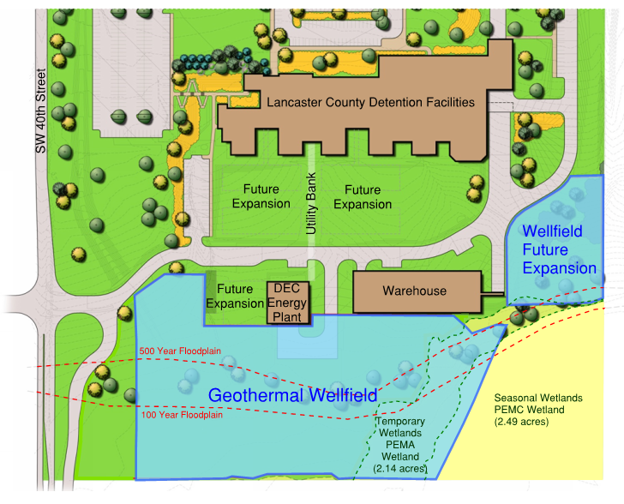
Overview of Geothermal Heat Pump Central Plant
Four Borefields in 8 Acres
667 Bores at 300 ft Depth
25 Nominal 70 Ton Water-to-Water Heat Pumps
1050 Tons Firm Capacity
Drilling 100% Complete
Circuit Installation 90% Complete
Circuit Tie-Ins to Plant 75% Complete

Slide 4
Energy Conservation Measures
Energy Recovery Systems
Daylight Sensors
Fluorescent Dimming
Control Management system
Ozone System for Laundry
Snowmelt Geothermal System
Variable Frequency Drives

Slide 5
Domestic Hot Water Pre-Heat
1st Stage - Piping to Allow Heat Transfer from DEC HWS, HWR, or CHWR Lines
2nd Stage - W-t-W Heat Pump in Building Using Borefield as Heat Source
Balances Load in Borefield (building is cooling dominated)
Projected Energy Cost Savings of at Least 35% for DHW Production

Slide 6
Sustainability
Projected 29% Energy Cost Savings Vs. a Conventional Thermal Plant
No Site Emissions
DHW Pre-Heat System Provides Balanced Load for Minimal Long-Term Ground Temperature Impact

Slide 7
Impact of the SW 40th TEF Geothermal System
Introduction of Geothermal Technology to District Energy Market
Demonstration of Reduction in Energy Consumption & Cost
Future Expansion Allows Versatility of Plant Growth Options
Data Collections to Support Application of Geothermal Technologies in District Energy Systems
Applications Secured Facility, Critical Load
Costs District Shares Capital Costs
Market District Energy
Performance
Load Diversity

Slide 8
Overview of Budget & Funding
Total Estimated Project Cost $20,132,824
$5 million ARRA Grant Received from Department of Energy in 2009
Requires Quarterly and Annual Progress Reports
Data Reporting for 3 Years Following Project Completion
Buy America Act Compliance
Davis-Bacon Act Compliance
Funds expended through March 2011 = $11,455,993
DOE Share = $3,260,341
DEC Share = $8,195,652
Geothermal System

